Slide 1
Web Application Development ISCG7420 Introduction to Web Development
School of Computing, Electrical and Applied Technology

Slide 2
Outlines
Custom post creation
Django registration
Custom user registration
File upload
Excel file reader
Sending Email
Firebase Storage

Slide 3
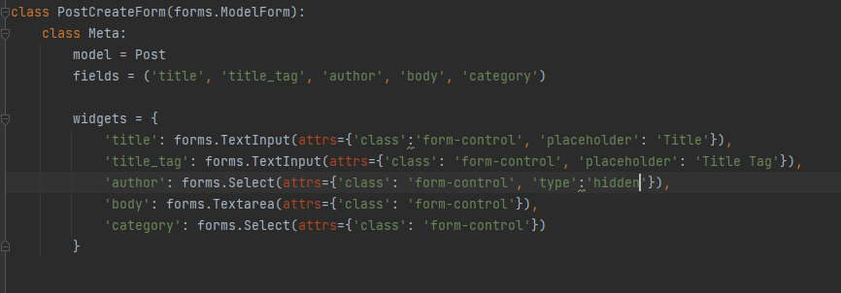
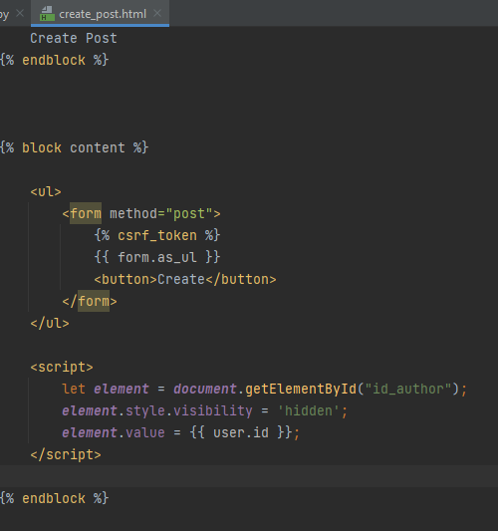
Custom post creation

Slide 4
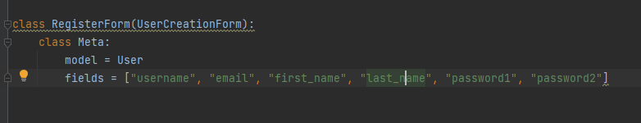
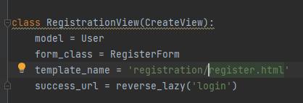
Django Registration
UserCreationForm
View

Slide 5
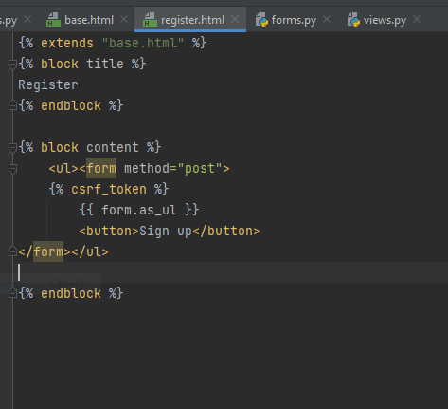

Django Registration
Template
urls

Slide 6
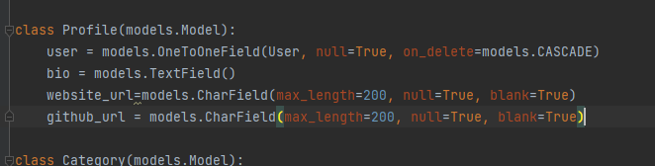
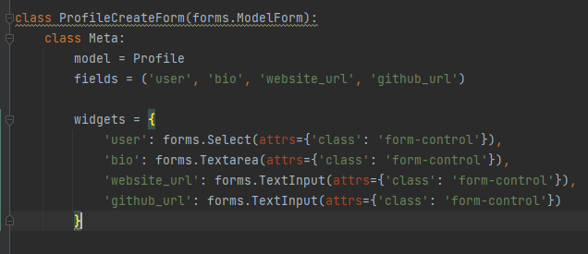
Profile
Model
Form

Slide 7
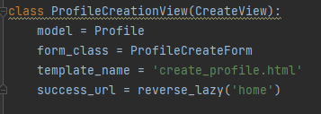
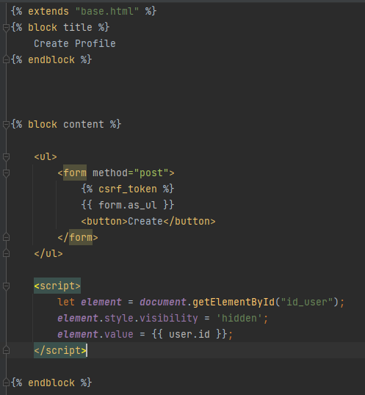
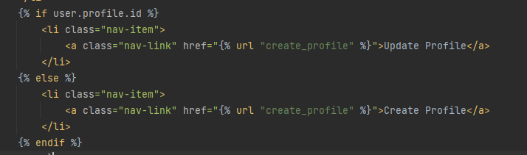
Profile
View
Template URLS
Base.html

Slide 8
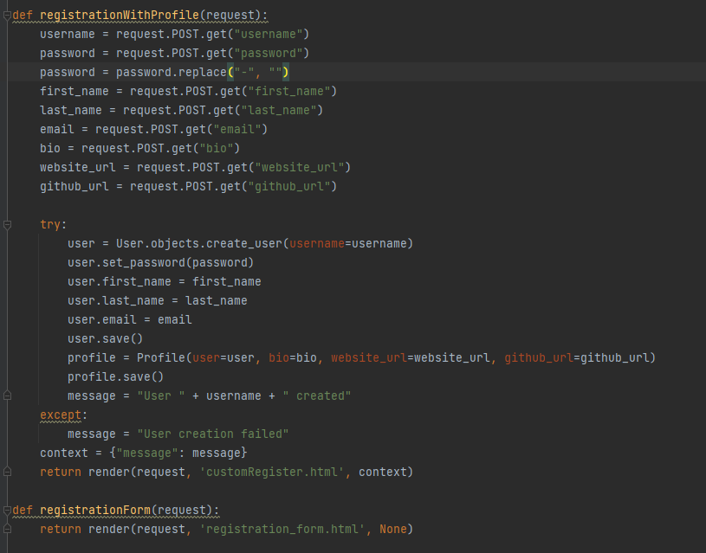
Custom user registration
View

Slide 9
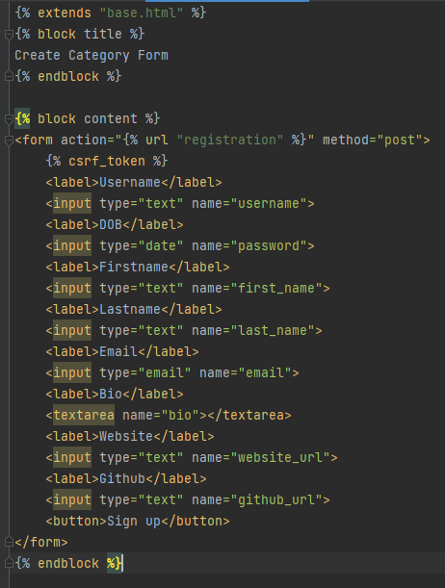
Custom user registration
Template - Form

Slide 10
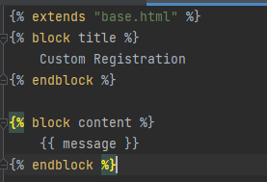
Custom user registration
Post page

Slide 11
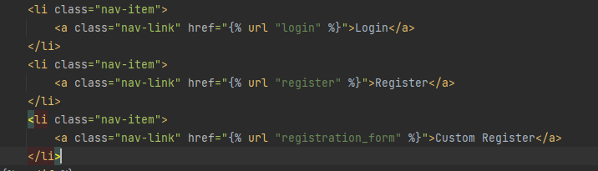
Custom user registration
Urls
Base.html

Slide 12

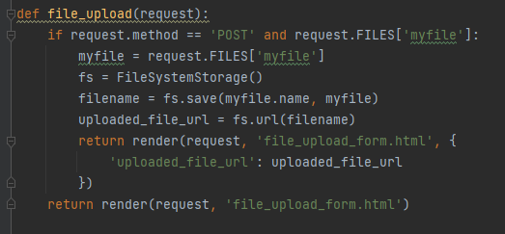
File upload
settings.py
View

Slide 13
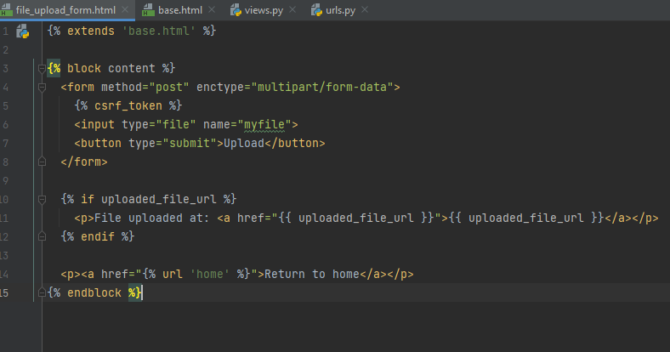

File upload
Template
Urls
Base.html

Slide 14
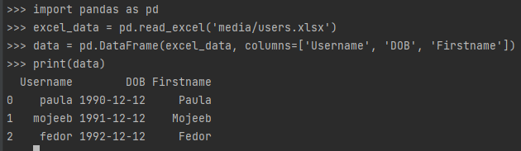
Excel Reader
https://linuxhint.com/read-excel-file-python/

Slide 15
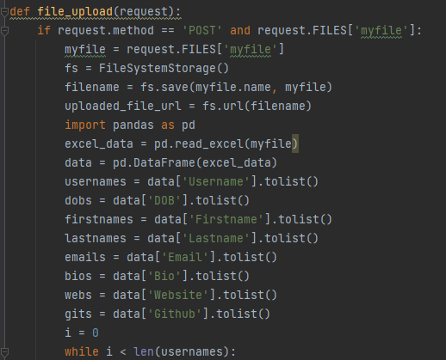
Update file_upload view

Slide 16
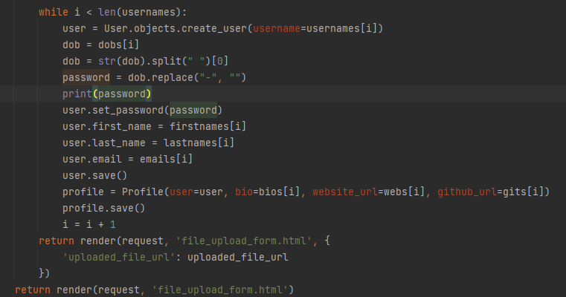
Update file_upload view

Slide 17
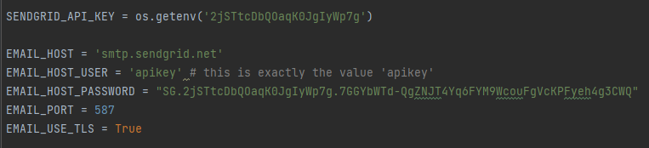
Sendgrid
https://sendgrid.com/
send_mail('Your grade has been published', 'Here is your grade', senderEmail, ['lsong@unitec.ac.nz'], fail_silently=False)

Slide 18
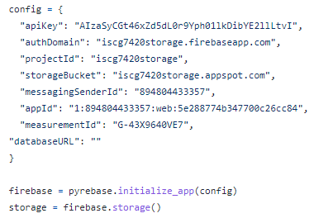
Firebase
https://firebase.google.com/
from django.core.files.storage import FileSystemStorage, default_storage
file_save = default_storage.save(uploaded_file.name, uploaded_file)
storage.child("files/" + uploaded_file.name).put("media/" + uploaded_file.name)
pip install pyrebase

